Slide 1
Chapter 2: System Structures
Reference: Chapter 2 of Silberschatz et al book, Operating System Concepts, 9th edition.

Slide 2
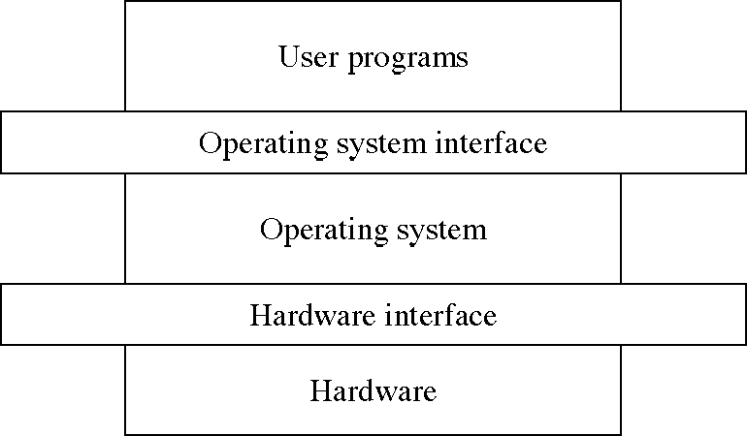
The OS Level Structure
(Current chapter)
(To be studied)

Slide 3
Chapter Objectives
To describe the services an operating system provides to users, processes, and other systems
To discuss the various ways of structuring an operating system
To explain how operating systems are installed and customized and how they boot

Slide 4
Outline
Operating System Services
User Operating System Interface
System Calls
Types of System Calls
System Programs
Operating System Design and Implementation
Operating System Structure
Virtual Machines
Operating System Debugging
Operating System Generation
System Boot

Slide 5
Operating System Services
Operating systems provide an environment for execution of programs and services to programs and users
One set of operating-system services provides functions that are helpful to the user:
  User interface - Almost all operating systems have a user interface (UI).
    Varies between Command-Line (CLI), Graphics User Interface (GUI), Batch
  Program execution - The system must be able to load a program into memory and to run that program, end execution, either normally or abnormally (indicating error)
  I/O operations - A running program may require I/O, which may involve a file or an I/O device
  File-system manipulation - The file system is of particular interest. Programs need to read and write files and directories, create and delete them, search them, list file Information, permission management.

Slide 6

Operating System Services (Cont.)
  Communications – Processes may exchange information, on the same computer or between computers over a network
    Communications may be via shared memory or through message passing (packets moved by the OS)
Message Passing
Shared Memory

Slide 7
Operating System Services (Cont.)
  Error detection – OS needs to be constantly aware of possible errors
    May occur in the CPU and memory hardware, in I/O devices, in user program
    For each type of error, OS should take the appropriate action to ensure correct and consistent computing
    Debugging facilities can greatly enhance the user’s and programmer’s abilities to efficiently use the system

Slide 8
Operating System Services (Cont.)
Another set of OS functions exists for ensuring the efficient operation of the system itself via resource sharing
  Resource allocation - When multiple users or multiple jobs running concurrently, resources must be allocated to each of them
    Many types of resources - Some (such as CPU cycles, main memory, and file storage) may have special allocation code, others (such as I/O devices) may have general request and release code
  Accounting - To keep track of which users use how much and what kinds of computer resources
  Protection and security - The owners of information stored in a multiuser or networked computer system may want to control use of that information, concurrent processes should not interfere with each other
    Protection involves ensuring that all access to system resources is controlled
    Security of the system from outsiders requires user authentication, extends to defending external I/O devices from invalid access attempts
    If a system is to be protected and secure, precautions must be instituted throughout it. A chain is only as strong as its weakest link.

Slide 9

A View of Operating System Services

Slide 10
Outline
Operating System Services
User Operating System Interface
System Calls
Types of System Calls
System Programs
Operating System Design and Implementation
Operating System Structure
Virtual Machines
Operating System Debugging
Operating System Generation
System Boot

Slide 11
User Operating System Interface - CLI
Command Line Interface (CLI) or command interpreter allows direct command entry
    Sometimes implemented in kernel, sometimes by systems program
    Sometimes multiple flavors implemented – shells
    Primarily fetches a command from user and executes it
      Sometimes commands built-in, sometimes just names of programs
        If the latter, adding new features doesn’t require shell modification

Slide 12
User Operating System Interface - GUI
User-friendly desktop metaphor interface
  Usually mouse, keyboard, and monitor
  Icons represent files, programs, actions, etc
  Various mouse buttons over objects in the interface cause various actions (provide information, options, execute function, open directory (known as a folder))
  Invented at Xerox PARC
Many systems now include both CLI and GUI interfaces
  Microsoft Windows is GUI with CLI “command” shell
  Apple Mac OS X as “Aqua” GUI interface with UNIX kernel underneath and shells available
  Solaris is CLI with optional GUI interfaces (Java Desktop, KDE)

Slide 13
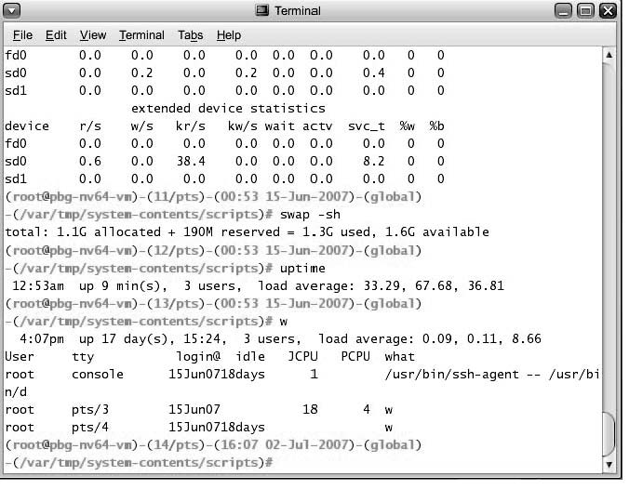
Bourne Shell Command Interpreter

Slide 14

The Mac OS X GUI

Slide 15
Outline
Operating System Services
User Operating System Interface
System Calls
Types of System Calls
System Programs
Operating System Design and Implementation
Operating System Structure
Virtual Machines
Operating System Debugging
Operating System Generation
System Boot

Slide 16
System Calls
Programming interface to the services provided by the OS
Typically written in a high-level language (C or C++)
Mostly accessed by programs via a high-level Application Program Interface (API) rather than direct system call use
Three most common APIs are Win32 API for Windows, POSIX API for POSIX-based systems (including virtually all versions of UNIX, Linux, and Mac OS X), and Java API for the Java virtual machine (JVM)

Slide 17

Example of System Calls
System call sequence to copy the contents of one file to another file

Slide 18

Example of Standard API
Consider the ReadFile() function in the
Win32 API—a function for reading from a file
A description of the parameters passed to ReadFile()
  HANDLE file—the file to be read
  LPVOID buffer—a buffer where the data will be read into and written from
  DWORD bytesToRead—the number of bytes to be read into the buffer
  LPDWORD bytesRead—the number of bytes read during the last read
  LPOVERLAPPED ovl—indicates if overlapped I/O is being used

Slide 19
System Call Implementation
Typically, a number associated with each system call
  System-call interface maintains a table indexed according to these numbers
The system call interface invokes intended system call in OS kernel and returns status of the system call and any return values
The caller need know nothing about how the system call is implemented
  Just needs to obey API and understand what OS will do as a result call
  Most details of OS interface hidden from programmer by API
    Managed by run-time support library (set of functions built into libraries included with compiler)

Slide 20

API – System Call – OS Relationship

Slide 21

Standard C Library Example
C program invoking printf() library call, which calls write() system call

Slide 22
System Call Parameter Passing
Often, more information is required than simply identity of desired system call
  Exact type and amount of information vary according to OS and call
Three general methods used to pass parameters to the OS
  Simplest: pass the parameters in registers
    In some cases, may be more parameters than registers
  Parameters stored in a block, or table, in memory, and address of block passed as a parameter in a register
    This approach taken by Linux and Solaris
  Parameters placed, or pushed, onto the stack by the program and popped off the stack by the operating system
  Block and stack methods do not limit the number or length of parameters being passed

Slide 23

Parameter Passing via Table

Slide 24
Types of System Calls
Process control
  end, abort
  load, execute
  create process, terminate process
  get process attributes, set process attributes
  wait for time
  wait event, signal event
  allocate and free memory
File management
  create file, delete file
  open, close file
  read, write, reposition
  get and set file attributes

Slide 25
Types of System Calls (Cont.)
Device management
  request device, release device
  read, write, reposition
  get device attributes, set device attributes
  logically attach or detach devices
Information maintenance
  get time or date, set time or date
  get system data, set system data
  get and set process, file, or device attributes
Communications
  create, delete communication connection
  send, receive messages
  transfer status information
  attach and detach remote devices

Slide 26

Examples of Windows and
Unix System Calls

Slide 27
About System calls
The system calls are the instruction set of the OS virtual processor.

Slide 28
Types of System Calls: Process Control
Example: MS-DOS
Single-tasking
Shell invoked when system booted
Simple method to run program
  No process created
Single memory space
Loads program into memory, overwriting all but the kernel
Program exit -> shell reloaded

Slide 29

MS-DOS execution
(a) At system startup (b) running a program

Slide 30
Process Control
Example: FreeBSD
Unix variant
Multitasking
User login -> invoke user’s choice of shell
Shell executes fork() system call to create process
  Executes exec() to load program into process
  Shell waits for process to terminate or continues with user commands
Process exits with code of 0 – no error or > 0 – error code

Slide 31

FreeBSD Running Multiple Programs

Slide 32
Outline
Operating System Services
User Operating System Interface
System Calls
Types of System Calls
System Programs
Operating System Design and Implementation
Operating System Structure
Virtual Machines
Operating System Debugging
Operating System Generation
System Boot

Slide 33
System Programs
System programs provide convenient environment for program execution and development.
Some are user interfaces to system calls; some are more complex.
Each system call is usually supported by a system program.
  File/directory manipulation: create, delete, copy name, print, dump, list
  Status information: Programs that ask system information and display to users.
  File modification: Text editor programs
  Command interpreter
  Programming language support
    Compilers, assemblers, debuggers
  Loaders and linkers
    For enabling the execution of programs that start new processes and connect different ones.
  Application programs
    Text processing software, graphics support, spread sheets, games

Slide 34
System Programs
System programs provide a convenient environment for program development and execution. They can be divided into:
  File manipulation
  Status information
  File modification
  Programming language support
  Program loading and execution
  Communications
  Application programs
Most users’ view of the operation system is defined by system programs, not the actual system calls

Slide 35
System Programs
Provide a convenient environment for program development and execution
  Some of them are simply user interfaces to system calls; others are considerably more complex
File management - Create, delete, copy, rename, print, dump, list, and generally manipulate files and directories
Status information
  Some ask the system for info - date, time, amount of available memory, disk space, number of users
  Others provide detailed performance, logging, and debugging information
  Typically, these programs format and print the output to the terminal or other output devices
  Some systems implement a registry - used to store and retrieve configuration information

Slide 36
System Programs (Cont.)
File modification
  Text editors to create and modify files
  Special commands to search contents of files or perform transformations of the text
Programming-language support - Compilers, assemblers, debuggers and interpreters sometimes provided
Program loading and execution- Absolute loaders,
relocatable loaders, linkage editors, and overlay-loaders, debugging systems for higher-level and machine language
Communications - Provide the mechanism for creating virtual connections among processes, users, and computer systems
  Allow users to send messages to one another’s screens, browse web pages, send electronic-mail messages, log in remotely, transfer files from one machine to another

Slide 37
Outline
Operating System Services
User Operating System Interface
System Calls
Types of System Calls
System Programs
Operating System Design and Implementation
Operating System Structure
Virtual Machines
Operating System Debugging
Operating System Generation
System Boot

Slide 38
System Design and Implementation
:design goals
We discuss problems we face while designing and implementing a system
First problem is defining the goals
  Batch, time-shared, single-user, multi-user, distributed, real-time, or general purpose.
The goals can be divided into two parts: user goals and system goals
  Users: Convenient to use, easy to learn, easy to use, reliable, safe, and fast.
  System goals by designers: easy to design, create, maintain, and operate. It should be flexible, reliable, and error-free.
  Ex: MSDOS is single user OS; MVS (multiple virtual storage) is a multiuser, multi access OS for IBM mainframes.
Software engineering principles can be applied for deciding goals.

Slide 39
Mechanisms and Policies
The specification and design of OS is highly creative task.
One important principle is separation of policy and mechanism.
Mechanisms do not change often; Policies may change
Mechanisms describe how things are done
  For CPU protection, timer will be used.
  Does not include decisions as to which process gets priority
Policies describe what will be done
  Deciding whether processes with more I/O get priority over CPU bound processes is an example
  This policy can be a input parameter and can change from scheduler to scheduler
  For CPU protection, how long the timer is set is a policy decision.
A mechanism which is insensitive to change in policy is preferred.
Micro-kernel OSs only implement mechanisms. Policies are provided at user level

Slide 40
Implementation
Assembly language can be used.
  High speed
High level language
  Easy to develop, easy to understand and debug, easy to port.
  UNIX was written in C.
  Dis adv: reduced speed and increased storage requirements.
  We have sophisticated compilers.
After writing in high-level language, bottleneck portion can be replaced by assembly language.

Slide 41
Outline
Operating System Services
User Operating System Interface
System Calls
Types of System Calls
System Programs
Operating System Design and Implementation
Operating System Structure
Virtual Machines
Operating System Debugging
Operating System Generation
System Boot

Slide 42

Simple Structure
MS-DOS – written to provide the most functionality in the least space
  Not divided into modules
  Although MS-DOS has some structure, its interfaces and levels of functionality are not well separated

Slide 43
UNIX
UNIX – limited by hardware functionality, the original UNIX operating system had limited structuring. The UNIX OS consists of two separable parts
  Systems programs
  The kernel
    Consists of everything below the system-call interface and above the physical hardware
    Provides the file system, CPU scheduling, memory management, and other operating-system functions; a large number of functions for one level

Slide 44

Traditional UNIX System Structure

Slide 45
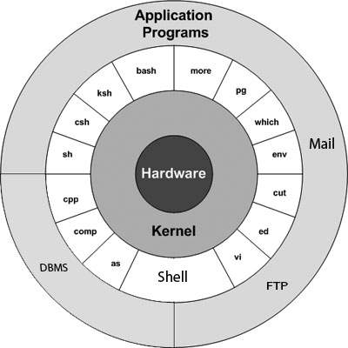
Traditional UNIX System Structure

Slide 46
Structure view: Structure of OS designs
Traditionally adhoc and unstructured approaches.
Structured designs
  Layered approach is followed to realize modularity
  Encapsulate the modules separately
  Have a hierarchy of layers where each layer calls procedures from the layers below.
The VENUS OS (Liskov)
  Layer 0 : Hardware
  Layer 1: Instruction interpreter
  Layer 2: CPU scheduler
  Layer 3: I/O channel
  Layer 4: Virtual memory
  Layer 5: device drivers and schedulers
  Layer 6: user program layer
The THE OS (Dijkstra)
  Layer 0 : Hardware
  Layer 1: CPU scheduler
  Layer 2: Memory manager
  Layer 3: Operator-console device driver
  Layer 4: I/O buffering
  Layer 5: user program layer

Slide 47
Structure view: layered system design
A general philosophy that builds on the above approach
  Decompose functionality into layers such that
    Hardware is level 0, and layer t accesses functionality at layer (t-1) or less
    Access via appropriately defined system calls.
Advantages
  Modular design: well defined interfaces between layers
  Prototyping/development
    Association between function and layer eases overall OS design.
    OS development and debugging is layer by layer.
    Simplifies debugging and system verification
New
operations
Layer M
Hidden
operations
Layer
M-1
Existing
operations

Slide 48
Layered Approach
The operating system is divided into a number of layers (levels), each built on top of lower layers. The bottom layer (layer 0), is the hardware; the highest (layer N) is the user interface.
With modularity, layers are selected such that each uses functions (operations) and services of only lower-level layers

Slide 49

Layered Operating System

Slide 50
OS design hierarchy: hypothetical model
Level | Name | Objects | Example operations
15 | Shell | User programming environment | Statements in shell language
14 | Directories (maintains association between external and internal identifiers of system resources and objects) | Directories | Create, destroy, search, list, access rights
13 | User Processes | User process | Fork, quit, kill, suspend, resume
12 | Stream I/O | streams | open., close
11 | Devices (access to external devices) | Printers, displays, and key boards | Create, destroy, open, close, read, write
10 | File system (long storage of named files) | files | Create, destroy, open, close
9 | Communications | pipes | Create, destroy, open, close, read, write
8 | Capabilities | Capabilities | Create, Validate, Attenuate
7 | Virtual memory (creating logical address space for programs) | Segments, pages | Read, write, fetch
6 | Local secondary storage (position of read/write heads) | Blocks of data, device channels | Read, write, allocate, free
5 | Primitive processes | Primitive process, semaphores, synchronization premitives | Suspend, resume, wait, signal
4 | Interrupts | Interrupts handling programs | Invoke, mask, unmask, retry
3 | Procedures | Procedures, call stack | Mark stack, call, return
2 | Instruction set | Evaluation, stack, micro-program, interpreter | Load, store, add, subtract, branch
1 | Electronic circuits | Registers, gates, busses | Clear, transfer, activate, complement

Slide 51
Design hierarchy: hypothetical model
Part of hardware
  Layer 1: Operations are actions on logic gates
  Layer 2: Operations are machine language instructions
  Layer 3: Call and return operations of procedures
  Layer 4: Interrupts Operations
Part of Core Operation system
  Layer 5: Operations to support multiple processes include ability to suspend and revoke process. Synchronization
  Layer 6: Operations on secondary storage devices (basic read, write and free blocks of data). Uses operations of layer 5.
  Layer 7: Create logical address space (virtual memory): Organizes virtual memory into blocks.
  Layer 8: Capabilities:
External to OSs
  Layer 9: Deals with communication of information and messages between processes. Deals with richer sharing of information. Notion of “pipe” is provided which is defined as with its output from one process and its input into another process.

Slide 52
Design hierarchy: hypothetical model
External to OSs
  Layer 10: Supports long term storage of named files. Data on secondary storage are viewed in terms of abstract, variable length entities. (Different from layer 6 which views storage as tracks, sectors, and fixed size blocks)
  Layer 11: Provides access to external devices using standard interfaces
  Layer 12: Stream I/O.
  Layer 13: Operations on Directories: Maintains the association between the external and internal identifiers of the system’s resources and objects. External identifier is used by user. Internal identifier is used by lower levels of operating system to locate and control the object.
  Layer 14: Provides full feature facility to support processes. Virtual address space, list of objects processes may interact other characteristics of processes the OS wants to use.
  Layer 15: Provides Shell: which accepts user commands or job control statements, interprets these and starts processes as needed.

Slide 53
Microkernel System Structure
Moves as much from the kernel into “user” space
Communication takes place between user modules using message passing
Benefits:
  Easier to extend a microkernel
  Easier to port the operating system to new architectures
  More reliable (less code is running in kernel mode)
  More secure
Detriments:
  Performance overhead of user space to kernel space communication through message passing.

Slide 54
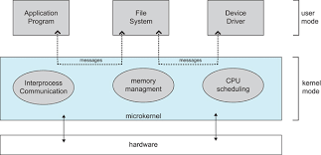
Architecture of a typical microkernel

Slide 55
Modules
Most modern operating systems implement kernel modules
  Uses object-oriented approach
  Each core component is separate
  Each talks to the others over known interfaces
  Loadable kernel modules
    Each is loadable as needed within the kernel
Overall, similar to layers but with more flexible

Slide 56

Solaris Modular Approach
Primary module is a core module and communicates with
other modules.
Modules need not invoke message passing for communication
Support different file systems with loadable modules.

Slide 57
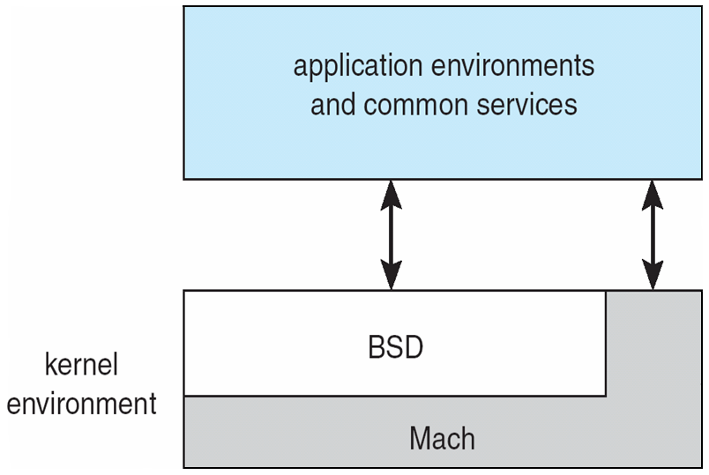
Mac OS X Structure: Hybrid Structure
* BSD: Berkeley Software distribution of UNIX OS

Slide 58
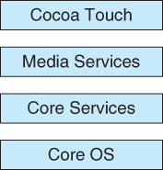
Architecture of Apple’s IOS
* iOS: iPhone OS

Slide 59
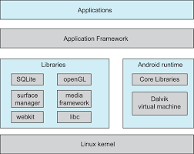
Architecture of Android

Slide 60
Outline
Operating System Services
User Operating System Interface
System Calls
Types of System Calls
System Programs
Operating System Design and Implementation
Operating System Structure
Virtual Machines
Operating System Debugging
Operating System Generation
System Boot

Slide 61
Structure view: Virtual machines
System programs above kernel can use either system calls or hardware instructions.
System programs treat the hardware and the system calls as though they both are at the same level.
In general application programs may view everything under them in the hierarchy as a part of machine itself, which leads to the concept of virtual machines..
The virtual machine approach provides an interface that is identical to the underlying bare hardware.
Each process is provided with a (virtual) copy of the underlying computer.
The resources of the physical computer are shared to create the virtual machines.
  CPU scheduling and spooling are used.

Slide 62
Structure view: Virtual machines
Logical conclusion of layered approach.
  The OS offers an abstract machine to execute on
    Hides the specifics and details of hardware
  Users are given their own VM, they can run any of the OS or software packages that are available on the underlying machine.
  Provides a complete copy of underlying machine to the user
    Pioneered under the name virtual machine (VM) by IBM
    Became a household name with JAVA
Mechanism of creating this illusion
  CPU scheduling
    Sharing the CPU in a transparent way
  Memory management
    Having large virtual memory space to address
  Additional features such as file systems and so on are offered through file management subsystems
    Problem is with partitioning the disk
      VM introduced minidisks such partitioning of tracks on the physical disk.

Slide 63
Layered Operating System

Slide 64
Virtual Machines
A virtual machine takes the layered approach to its logical conclusion. It treats hardware and the operating system kernel as though they were all hardware.
A virtual machine provides an interface identical to the underlying bare hardware.
The operating system host creates the illusion that a process has its own processor and (virtual memory).
Each guest provided with a (virtual) copy of underlying computer.

Slide 65
Virtual Machines History and Benefits
First appeared commercially in IBM mainframes in 1972
Fundamentally, multiple execution environments (different operating systems) can share the same hardware
Protect from each other
Some sharing of file can be permitted, controlled
Commutate with each other, other physical systems via networking
Useful for development, testing
Consolidation of many low-resource use systems onto fewer busier systems
“Open Virtual Machine Format”, standard format of virtual machines, allows a VM to run within many different virtual machine (host) platforms

Slide 66
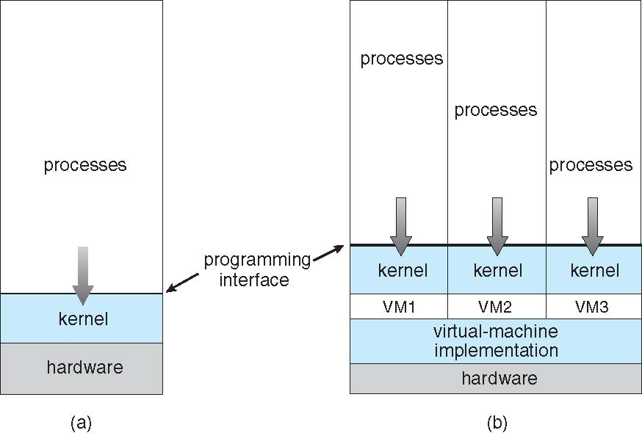
Virtual Machines (Cont.)
(a) Nonvirtual machine (b) virtual machine

Slide 67
Para-virtualization
Presents guest with system similar but not identical to hardware
Guest must be modified to run on paravirtualized hardware
Guest can be an OS, or in the case of Solaris 10 applications running in containers

Slide 68
Virtualization Implementation
Difficult to implement – must provide an exact duplicate of underlying machine
  Typically runs in user mode, creates virtual user mode and virtual kernel mode
Timing can be an issue – slower than real machine
Hardware support needed
  More support-> better virtualization
  i.e. AMD provides “host” and “guest” modes

Slide 69
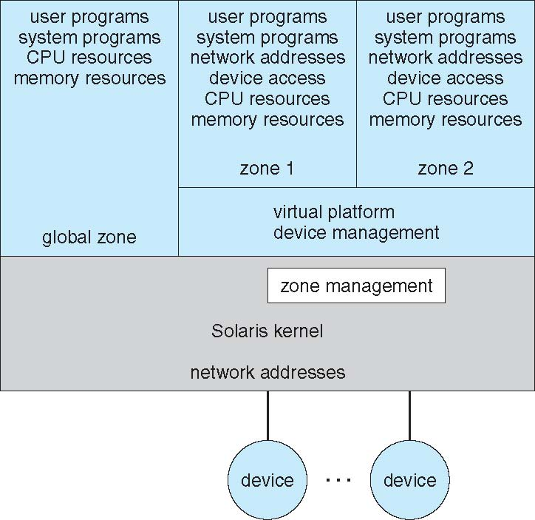
Solaris 10 with Two Containers

Slide 70
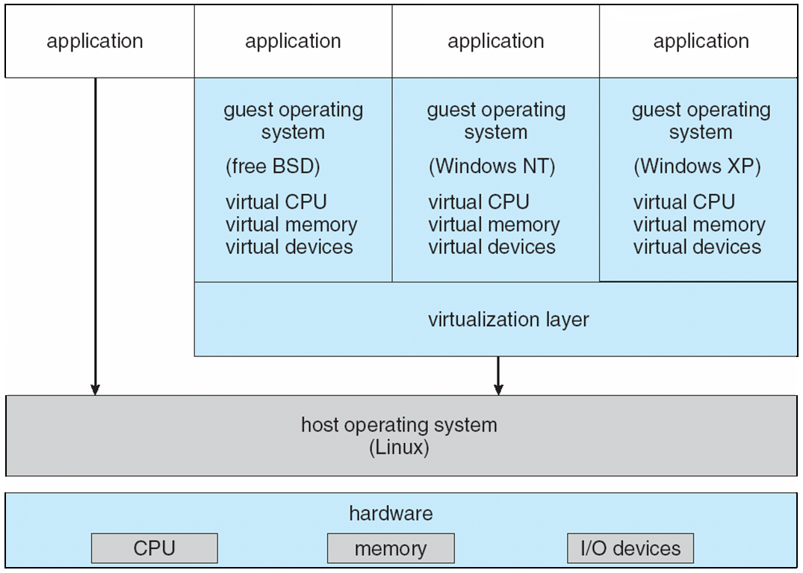
VMware Architecture

Slide 71
Structure view: Virtual machines (cont..)
Operation
  User-level code executes as is
  Supervisor code executes at user level
    Privileged instructions are simulated.
      Generate trap to VM emulator
    Hidden registers and I/O instructions are simulated.
  Virtual machine software has two modes
    User mode and monitor mode
  The user program will execute in two modes
    Virtual user mode
    Virtual monitor mode

Slide 72
Structure view: Virtual machines (cont..)
Advantages
  A software created abstraction that is a replica of the underlying machine
  Additional functionality can be provided
    Can run different OSs on different VMs.
  Each VM is completely isolated from others, so secure.
  Protection of various system resources.
  It can be used for OS research and development.
  System programs are given their own virtual machine.
  Thousands of programs are available for MSDOS on Intel CPU-based systems.
  SUN micro-systems and DEC use faster machines
    To test MSDOS programs on the faster machines, the best way is to provide a virtual Intel machine.
  System compatibility problems can be solved
Disadvantages
  Performance degradation is inevitable

Slide 73
JAVA
JAVA is designed by SUN Micro systems.
JAVA compiler generates byte code output.
These instructions run on Java virtual machine.
JVM runs on many types of computer.
JVM is implemented in web browsers.
JVM implements a stack based instruction set.

Slide 74
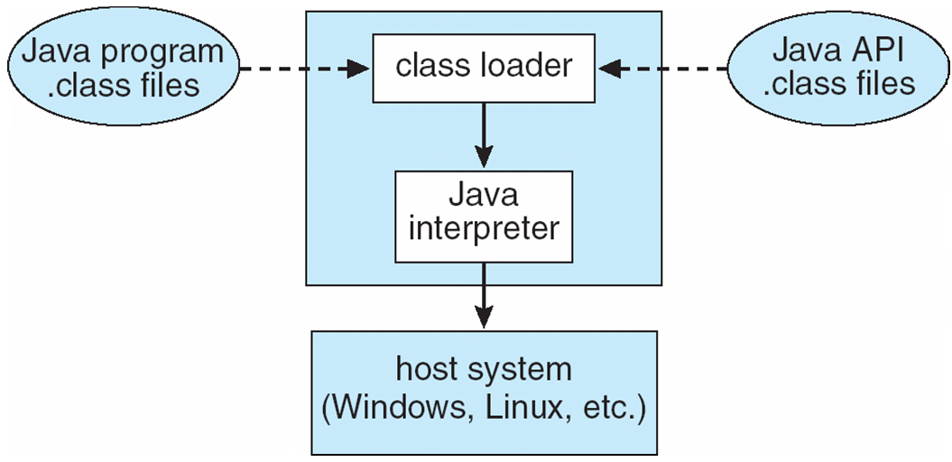
The Java Virtual Machine

Slide 75
Types of multiplexing
Time multiplexing
  time-sharing
  scheduling a serially-reusable resource among several users
Space multiplexing
  space-sharing
  dividing a multiple-use resource up among several users

Slide 76
Virtual computers
Processor virtualized to processes
  mainly time-multiplexing
Memory virtualized to address spaces
  space and time multiplexing
Disks virtualized to files
  space-multiplexing
  transforming

Slide 77
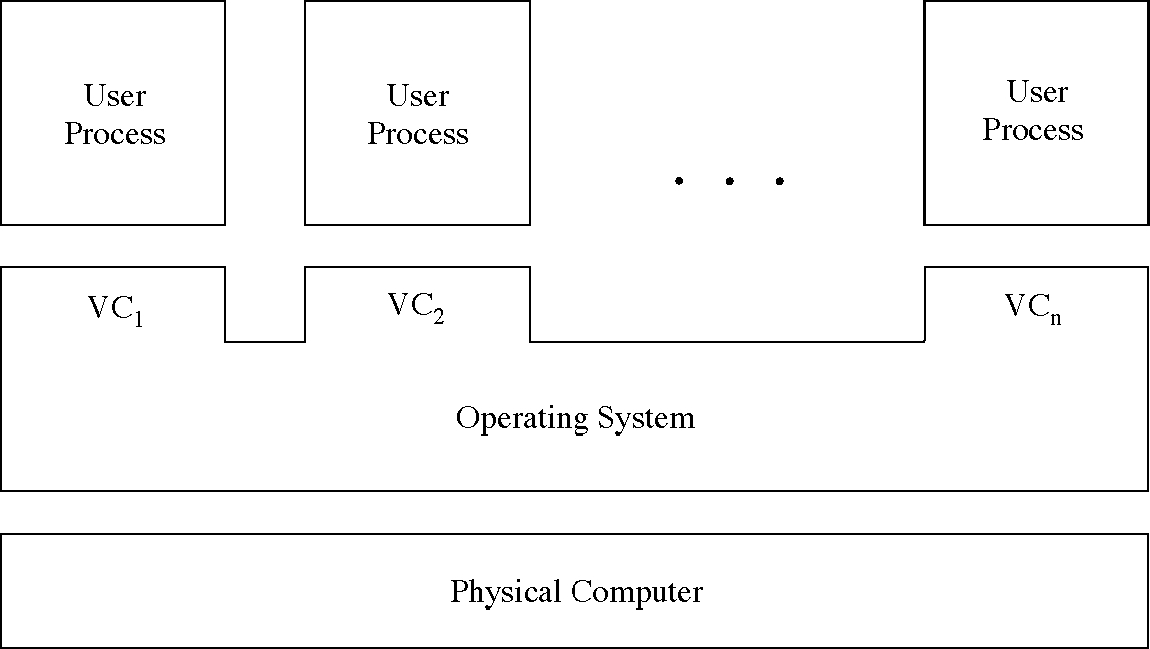
Multiple virtual computers

Slide 78
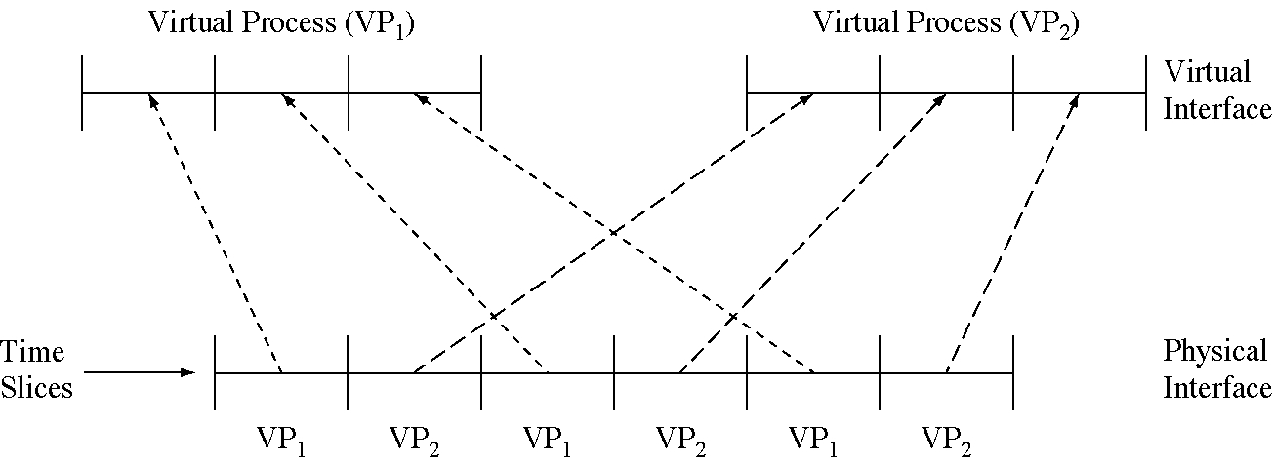
Time-multiplexing the processor

Slide 79
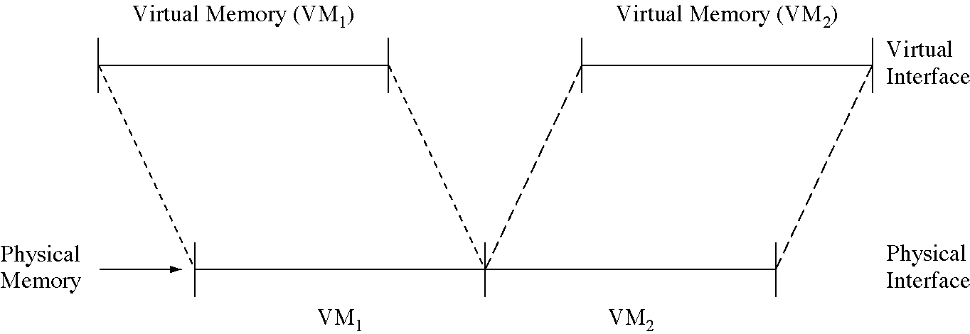
Space-multiplexing memory

Slide 80
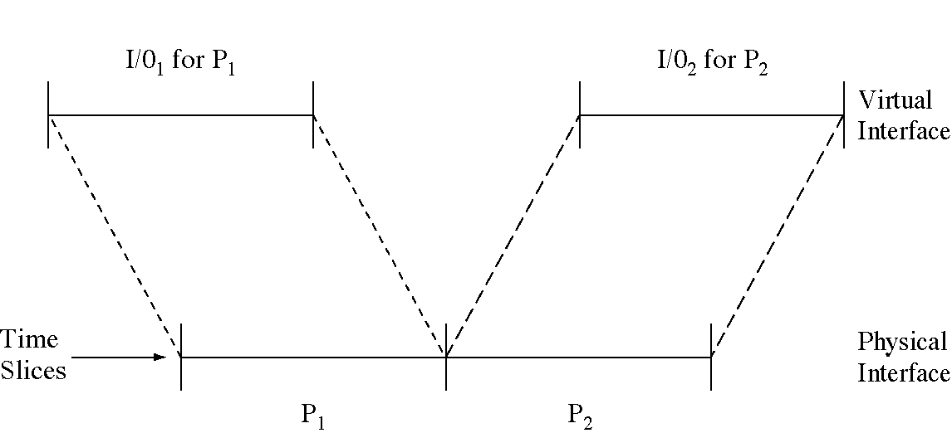
Time-multiplexing I/O devices

Slide 81
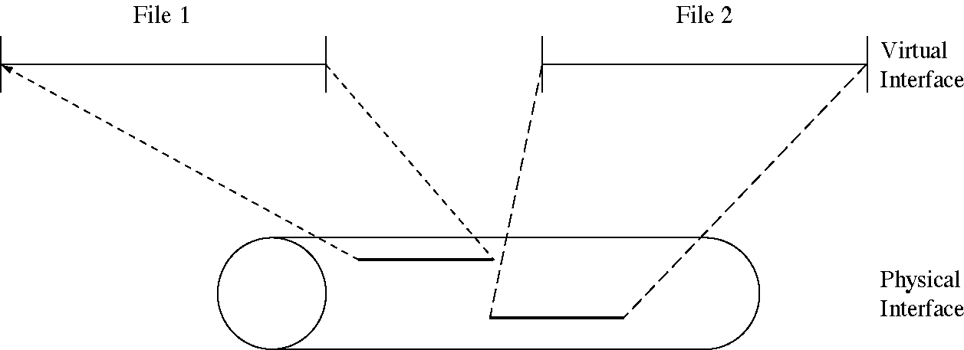
Space-multiplexing the disk

Slide 82

System Models
Non-virtual Machine
Virtual Machine

Slide 83
Outline
Operating System Services
User Operating System Interface
System Calls
Types of System Calls
System Programs
Operating System Design and Implementation
Operating System Structure
Virtual Machines
Operating System Debugging
Operating System Generation
System Boot

Slide 84
Operating-System Debugging
Debugging is finding and fixing errors, or bugs
OSes generate log files containing error information
Failure of an application can generate core dump file capturing memory of the process
Operating system failure can generate crash dump file containing kernel memory
Beyond crashes, performance tuning can optimize system performance
Kernighan’s Law: “Debugging is twice as hard as writing the code in the first place. Therefore, if you write the code as cleverly as possible, you are, by definition, not smart enough to debug it.”
DTrace tool in Solaris, FreeBSD, Mac OS X allows live instrumentation on production systems
  Probes fire when code is executed, capturing state data and sending it to consumers of those probes

Slide 85

Solaris 10 dtrace Following System Call

Slide 86
System generation (SYSGEN)
The OS program is normally distributed on disk or tape.
A special program SYSGEN reads from a given file and asks the operator regarding specific configuration of the system.
  Probes the hardware directly to determine what components are there.
Regenerate/Configure the OS for new machine parameters
  CPU type
  Machine parameters include
    Memory size, I/O device parameters, address maps etc.
    Mechanisms describe how things are done
  Devices
  Options of OS
    CPU scheduling algorithm, buffer size.
Approaches
  Recompile
  Have precompiled parameterized libraries: link rather than compiling
  Use table driven run-time selection

Slide 87
Operating System Generation
Operating systems are designed to run on any of a class of machines; the system must be configured for each specific computer site
SYSGEN program obtains information concerning the specific configuration of the hardware system
Booting – starting a computer by loading the kernel
Bootstrap program – code stored in ROM that is able to locate the kernel, load it into memory, and start its execution

Slide 88
System Boot
Operating system must be made available to hardware so hardware can start it
  Small piece of code – bootstrap loader, locates the kernel, loads it into memory, and starts it
  Sometimes two-step process where boot block at fixed location loads bootstrap loader
  When power initialized on system, execution starts at a fixed memory location
    Firmware used to hold initial boot code

Slide 89

END

